Slide 1

The Irish Education System
MJ Malone

Slide 2
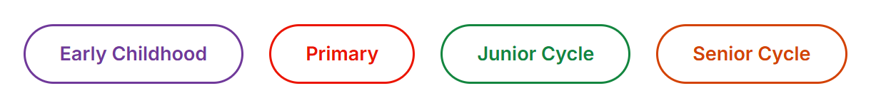
Irish Education System
The Early Childhood Care and Education scheme
provides up to 2 years of early childhood care and education for children of pre-school age.
Primary Education
Pupils age 4 (minimum) to 12 (approximately
Post-primary education has 2 stages:
Junior Cycle – age 12 to 15 (approximately)
Senior Cycle - age 16 to 18 (approximately)

Slide 3

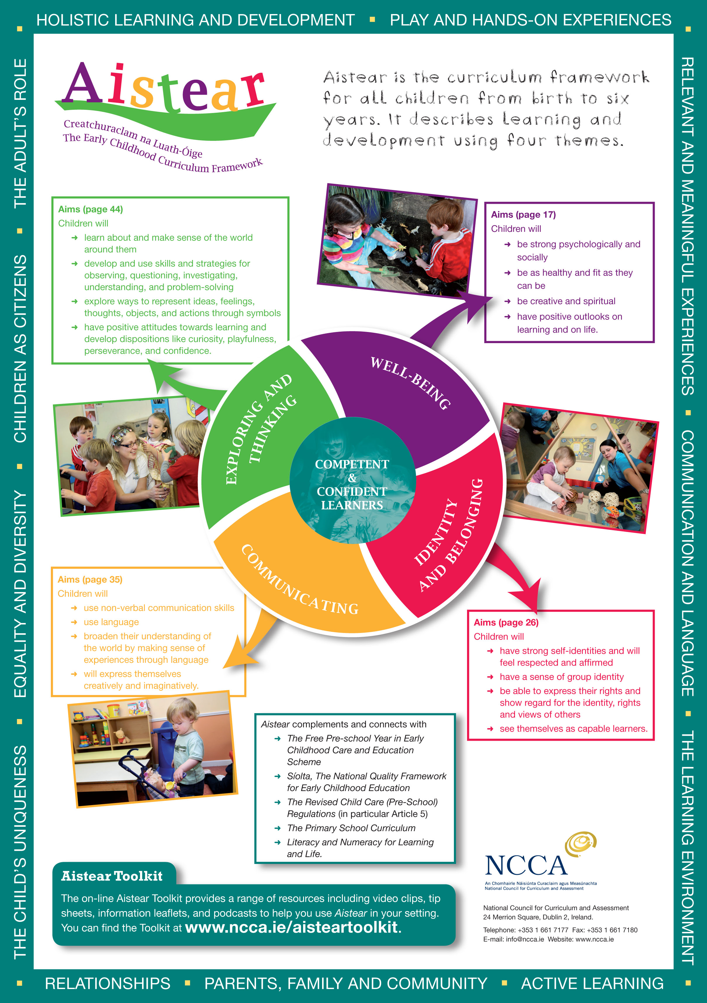
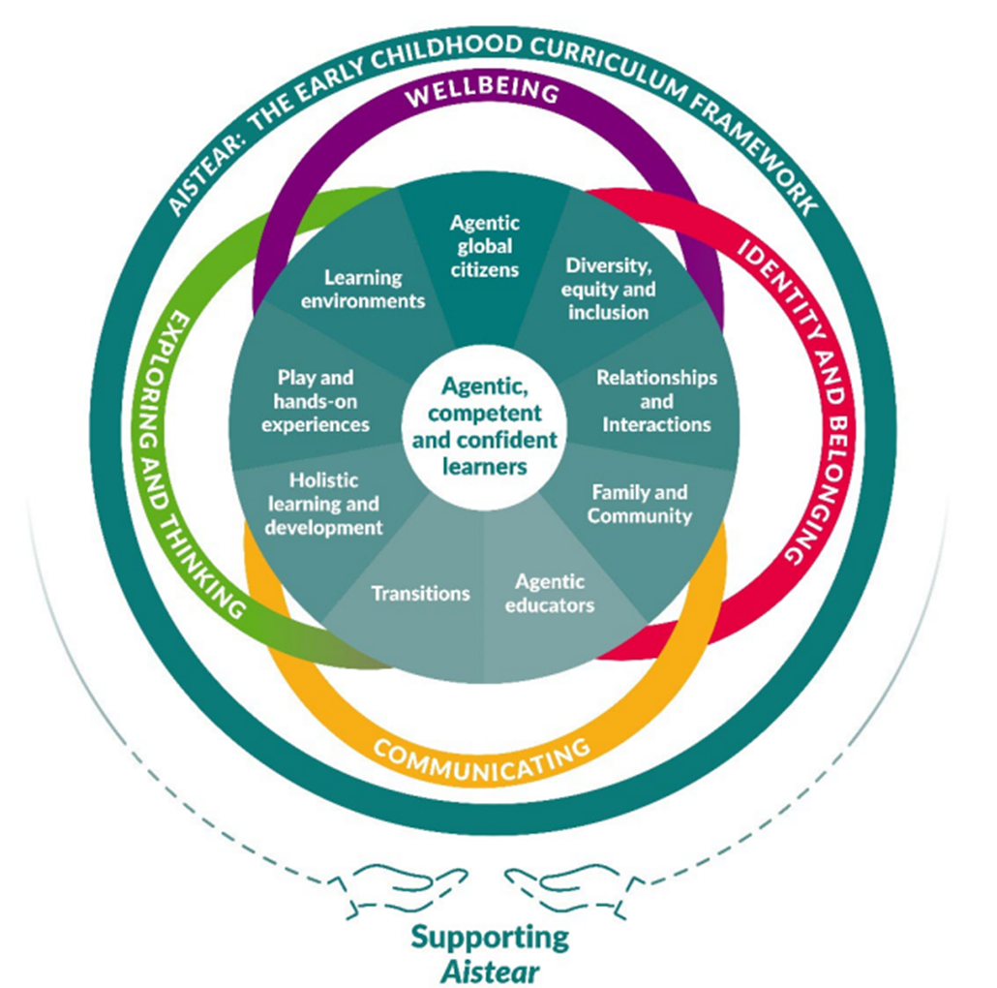

Slide 4
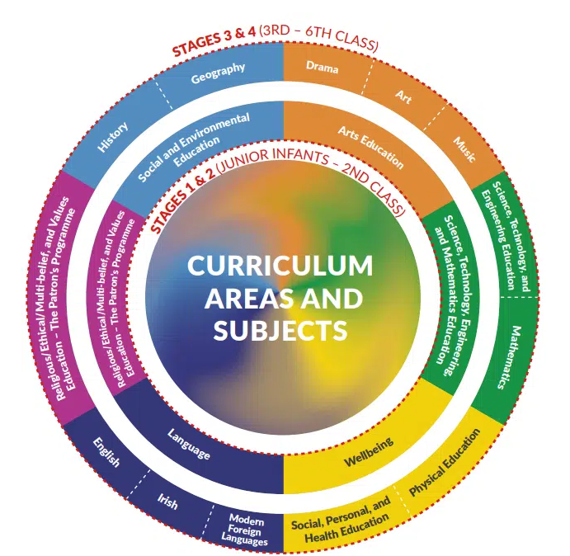

A typical school day:
Start: 09:00
Small break: 11:00 – 11:15
Lunch: 12:30 to 13:00
Home time Juniors and Senior infants: 13:45.
Home time 1st class to 6th class: 14:45
Irish Primary Curriculum
Reform
1971
1999
2023 onwards

Slide 5

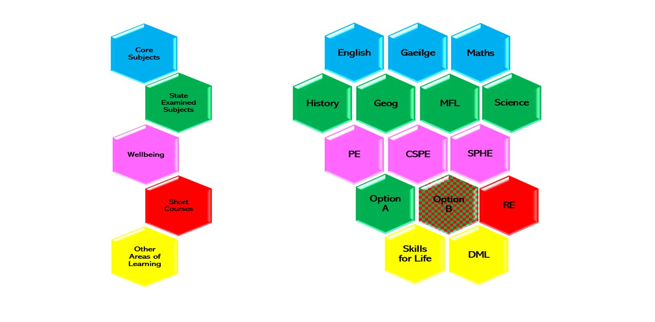

Slide 6

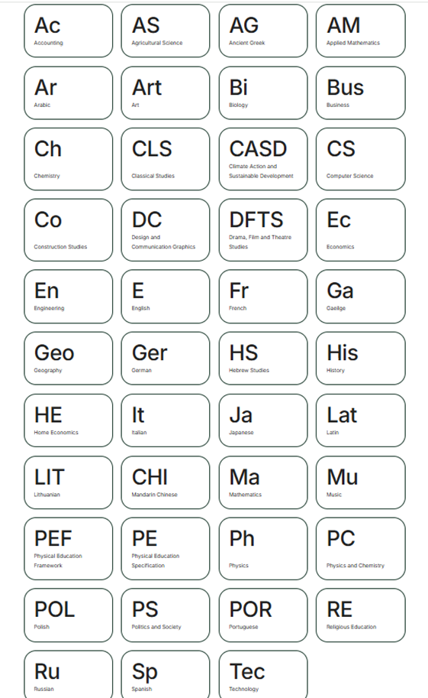
Leaving Certificate Established
The Leaving Certificate (Established) is a two-year programme that aims to provide learners with a broad, balanced education while also offering them a chance to specialise towards particular higher education and career options.
In general, students take five or more subjects (usually seven) for examination, one of which must be Irish (unless exempt). Subjects are normally studied at either Ordinary or Higher Level. Two subjects, Irish and Mathematics, can be studied at Foundation Level.
Syllabuses are available in 36 subjects.

Slide 7
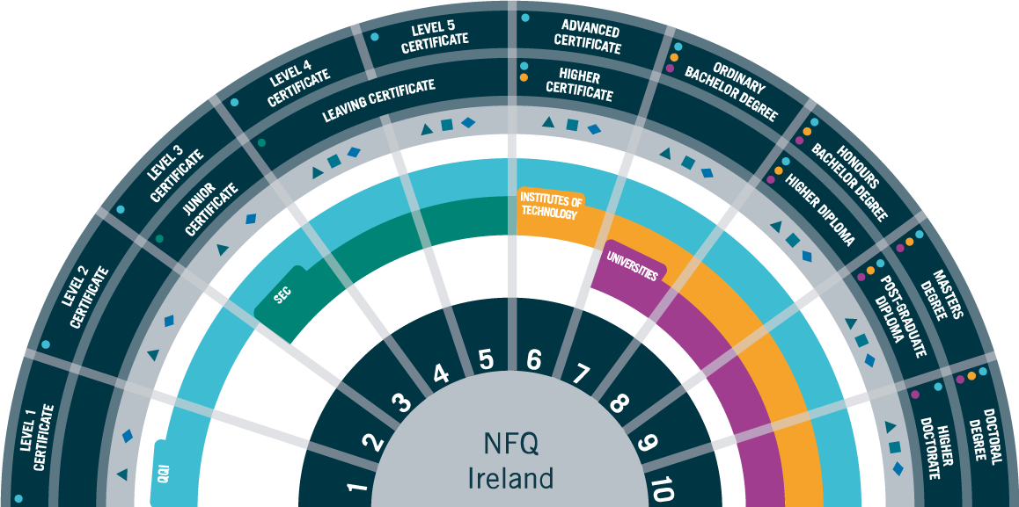
National Framework of Qualifications

